Slide 2
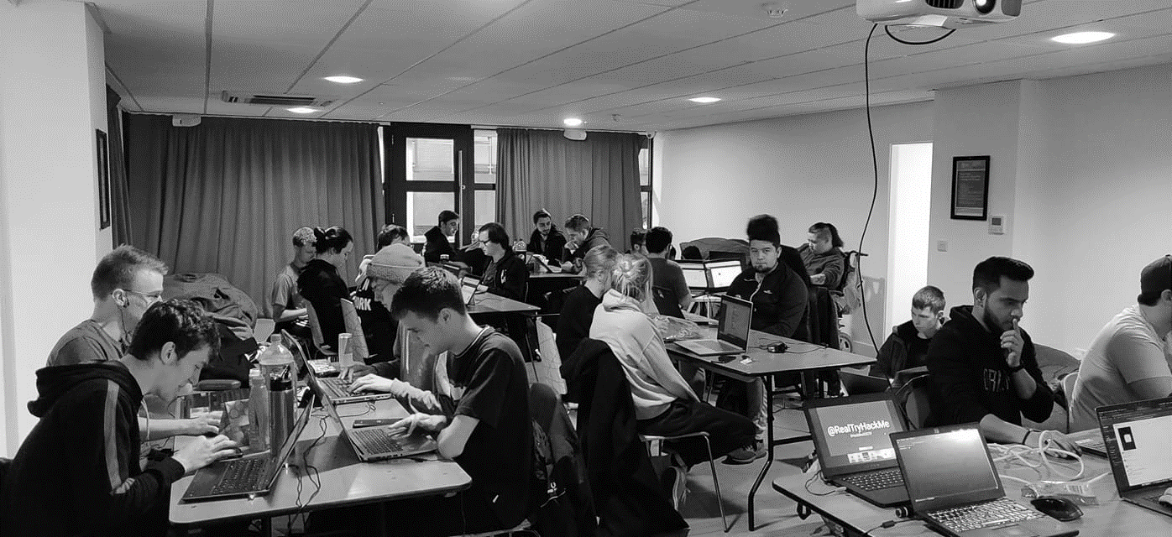



/dmuhackers
@dmuhackers
Reverse Engineering

Slide 3
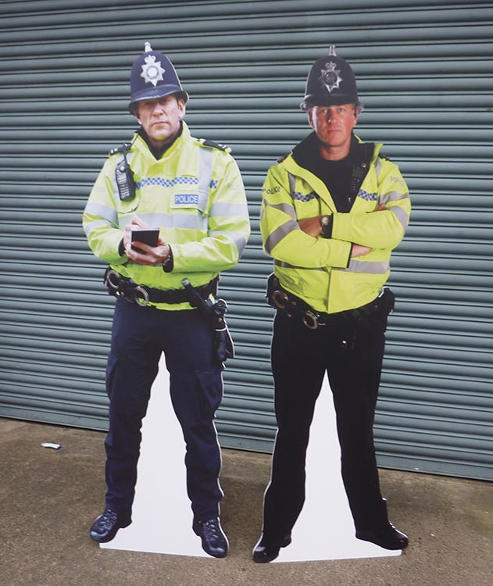


Disclaimer
Don’t do illegal shit

Slide 4
Announcements
Please let us know if you would like a hoodie by the end of next week’s hackers session
Please send Joe your food orders by next Wednesday or in his own words “you’ll starve”
Joint Hackers / eSports social, 7th December 2021 in Firebug. Turn up, show eSports why we are better
CTF this weekend
If anyone would like to help Sarah with an open day for 10 – 14 year olds, talk to Joe, looks good on your CV
Soar and Oddbar as usual for socials

Slide 5
Overview
What is Reverse Engineering?
Why is Reverse Engineering important?
Ghidra Showcase – Reverse Engineering tool
Following this presentation there will be a reverse engineering challenge to complete.

Slide 6
Reverse Engineering
With reverse engineering, it is exactly what it says on the tin. Reversing something that’s been engineered.
It’s a concept that exists outside Cyber Security, however in a Cyber Security sense it is crucial.
Anyone know why?

Slide 7

Reverse Engineering
Scenario 1 : Unknown Program
Below is runme.exe
You receive this in an email from an unknown source. Do you run this program?

Slide 8
Reverse Engineering
Scenario 1: Unknown Program
The program runme.exe is an innocent program that performs a ROT13 of text supplied.
M This makes Brandon = Oenaqba
Yet no one would run this program for security reasons. It is only through reverse engineering that we can grasp what the program is doing.

Slide 9
Reverse Engineering
Scenario 2 : Malware Analysis
Now for this, I’m going to use a real life example
Marcus Hutchins – Anyone know that name?
Let me help you out with just one word. Wannacry

Slide 10
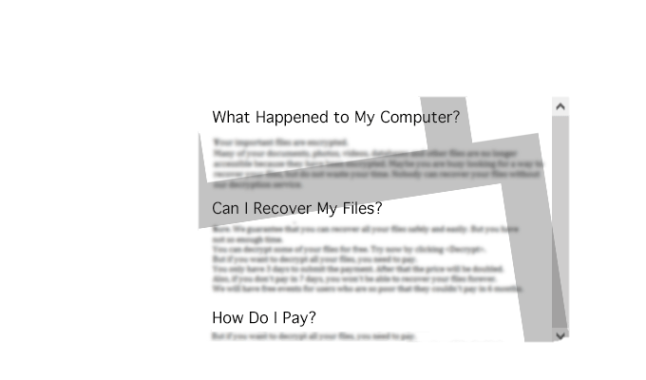
Reverse Engineering
Scenario 2 : Malware Analysis
How is this relevant to Reverse Engineering?
(simplified)
While Wannacry was wreaking havoc across the globe, Marcus had a look at a live sample of the malware.
Marcus discovered something odd. A redirect to a website like ‘jslfrb526dbajsfdhka.net’
So he registered the domain.

Slide 11
Reverse Engineering
Scenario 2 : Malware Analysis
With this, he managed to stop Wannacry from affecting some systems not all, but enough to make a difference
Essentially this became a killswitch and allowed Microsoft to have that extra crucial time to develop a patch. This also led to the domain he registered getting hit hard by a botnet in an attempt to bring it down.

Slide 12
Reverse Engineering
Scenario 2 : Malware Analysis
Now, this worked out, however it easily could have failed or been catastrophic. Wannacry could have had a logic bomb.
However, this shows another use case for reverse engineering.

Slide 13

Reverse Engineering
Scenario 3 : Capture the Flags
In most CTFs there are reverse engineering flags.
Often these will include a program, and there will be a specific way to “break” the program to get the flag.

Slide 14
Reverse Engineering
Scenario 3 : Capture the Flags
E.g.
## if var1 == ‘dmu’
M print(‘flag = ‘ flag_var)
## else
M print(‘Nope’)
Yes that code is horrendous, but you get the gist

Slide 15

Ghidra
Ghidra is a reverse engineering tool developed by our good friends at the NSA.
It allows for a program to be decompiled into assembly language and allows for users to work out the functions of a program.
Ghidra is free and open source and currently considered to be one of the best tools available.

Slide 16
Ghidra Install
First Install JDK
Sudo apt update
Sudo apt install default-jdk
Install Ghidra
Download ghidra_beta_public.zip
Unzip ghidra_beta_public.zip
Cd into the directory
Run the command “./ghidraRun”

Slide 17
Ghidra Use

Slide 18
Questions?
Please note that I am not an expert on reverse engineering

Slide 19
Practical
This is going to be available on the lab machines, and will be available on GitHub for those that want to continue

